Slide 1
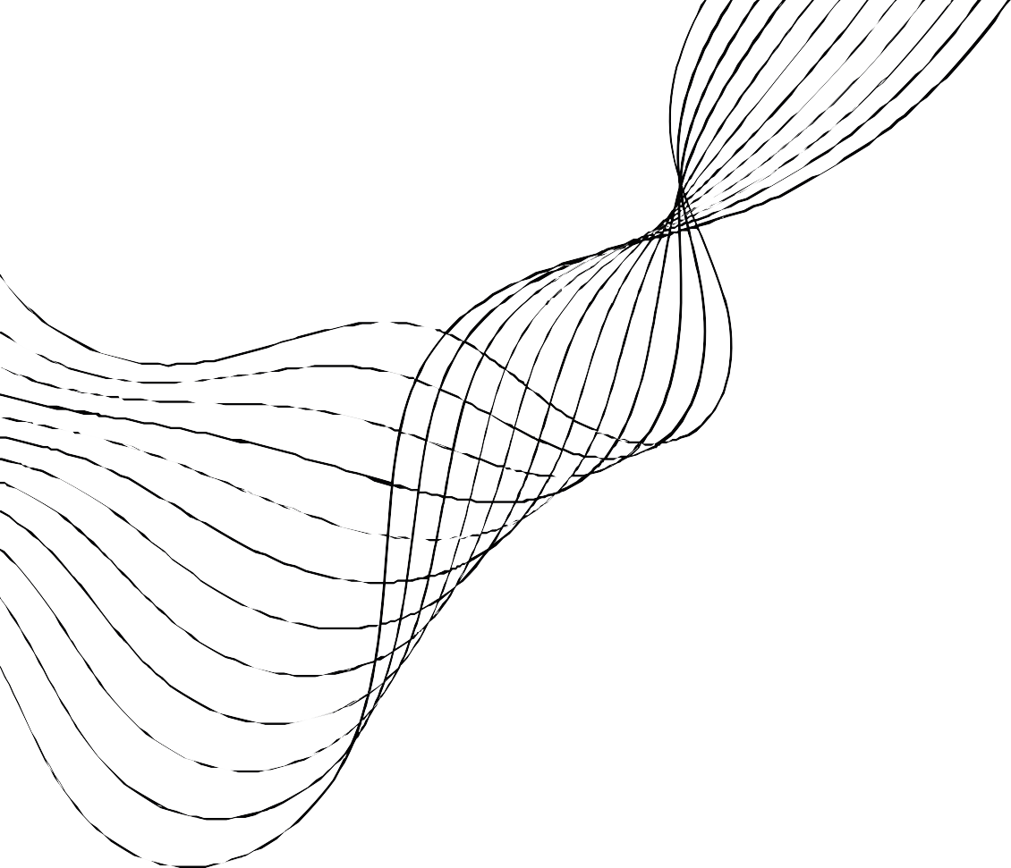
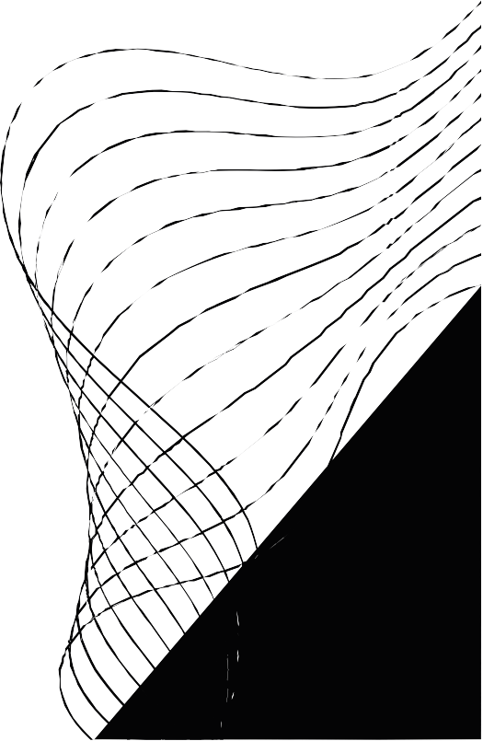
COVID- 19 CASES
ANALYSIS PROJECT DOCUMENTATION
PHASE-5

Slide 2


CONTENT
01
02
03
04
05
06
07
08
PROJECT OBJECTIVE
DESIGN THINKING PROCESS AND DEVELOPMENT PHASES
ANALYSIS OBJECTIVES AND METHODOLOGY
INSIGHTS AND THEIR IMPLICATIONS
UNDERSTANDING COVID-19 TRENDS AND IMPACTS
DATA COLLECTION PROCESS
VISUALIZATION USING IBM COGNOS
CONCLUSION

Slide 3



1 . PROJECT OBJECTIVE
The primary objective of the COVID-19 cases analysis
project was to explore and analyze the trends, patterns, and impacts of the COVID-19 pandemic using data-driven
methods. This involved examining the progression of cases, identifying hotspots, understanding demographic impacts, and deriving insights that could potentially aid in better
understanding and responding to the pandemic.

Slide 4




2 . DESIGN THINKING PROCESS AND DEVELOPMENT PHASES:
Understanding the Problem: Initial phase involved gathering information on the spread of COVID-19, available datasets, and defining the scope of analysis. Data Collection and Preprocessing: Retrieval of diverse COVID- 19 datasets from reliable sources (e.g., WHO, CDC) and preprocessing this data for analysis. Data Analysis and Visualization: Utilizing IBM Cognos and other data visualization tools to analyze the collected data, creating visual representations to comprehend the trends and patterns.
Insights Generation: Deriving insights by comparing data across regions, demographics, and time periods.

Slide 5


3 . ANALYSIS OBJECTIVES AND METHODOLOGY:
Data Collection Process: Multiple datasets were gathered, encompassing cases, deaths, recoveries, testing rates,
demographics, and geographical information. These datasets were cleaned, integrated, and made ready for analysis. Data Visualization using IBM Cognos was employed to create visualizations, such as
l ine graphs, heat maps, and dashboards, to represent the data comprehensively. Insights Generated: The analysis focused on
understanding the trajectory of the pandemic in different regions,
identifying the correlation between public health interventions and case rates, and examining demographic disparities in COVID-19
impacts.

Slide 6

4 . INSIGHTS AND THEIR IMPLICATIONS:
Trend Analysis: Clear trends were observed in the rise and fall of cases over time, with spikes coinciding with certain events or policy changes. Geographical Hotspots: Identification of areas with high case rates helped in understanding the necessity for targeted interventions.
Demographic Disparities: Analysis of the impact on different age groups, ethnicities, and socioeconomic statuses highlighted disparities in susceptibility and outcomes.

Slide 7

5 . UNDERSTANDING COVID- 19 TRENDS
AND IMPACTS:
The insights derived from the analysis can be instrumental in several ways:
1. Public Health Interventions:
Understanding what interventions have worked in controlling the spread.
2. Resource Allocation: Directing resources towards the most affected areas and
vulnerable demographics.
3. Policy Decisions: Informing policy decisions to better respond to similar future health crises.

Slide 8


6 . DATA COLLECTION PROCESS:
The data collection process for the COVID-19 analysis project involved the following steps:
Identification of Reliable Data Sources: The first step was to identify and gather data from credible sources such as the World Health Organization (WHO), Centers for Disease Control and Prevention (CDC), John Hopkins University, government health departments, and other reputable sources providing COVID-19 related datasets.
Data Retrieval: Various datasets were collected, covering a range of COVID-19 metrics including daily cases, deaths, recoveries, testing rates, hospitalizations, demographic information, and geographic data. These datasets were available in different formats such as CSV, JSON, or through APIs.
Data Cleaning and Preprocessing: The collected data required cleaning and preprocessing to ensure consistency, accuracy, and compatibility. This step involved dealing with missing values, standardizing date formats, harmonizing data fields, and ensuring uniformity across different sources.
Data Integration: The cleaned datasets were integrated to create a comprehensive dataset for analysis. This process involved merging multiple datasets based on common fields such as date, location, or unique identifiers to create a unified dataset suitable for analysis.
Data Quality Check: A quality check was conducted to verify the accuracy of the integrated dataset. This involved cross-validating the data, identifying anomalies, and ensuring data integrity.

Slide 9


7 . VISUALIZATION USING IBM COGNOS:
The IBM Cognos tool was selected for i ts robust data
visualization capabilities.
The tool was configured and prepared for data
integration and visualization.
The integrated dataset obtained from the data collection process was
imported into IBM Cognos
Using IBM Cognos, various types of visualizations were created to represent the
COVID-19 data comprehensively.
Showing trends in daily cases, deaths, and
recoveries over t ime.
IBM Cognos allowed for
interactive analysis, enabling users to drill down into
specific data points, f i l ter
information, and explore the data dynamically.
IBM COGNOS SETUP:
DATA IMPORT:
VISUALIZATION CREATION:
LINE GRAPHS:
INTERACTIVE ANALYSIS:

Slide 10

8 . CONCLUSION
The project successfully delved into the vast array of COVID-19 data available and drew meaningful insights to aid in understanding the trends, impacts, and potential strategies for managing the pandemic.

Slide 11



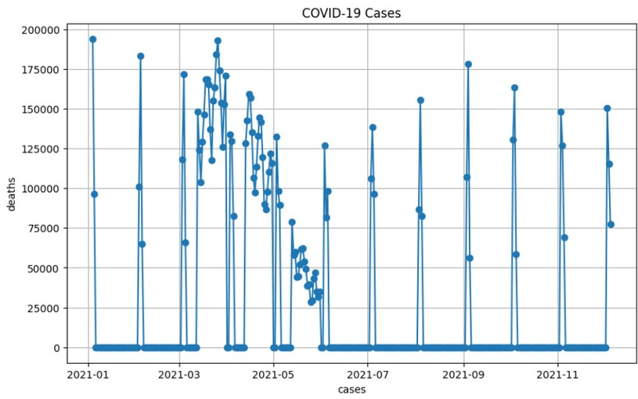
CODING
import pandas as pd
import matplotlib. pyplot as plt
output
data = pd. read_csv(' Covid_19_cases4. csv')
data[' date Rep'] = pd. to_datetime( data[' date Rep']) data. set_index(' date Rep', inplace=True)
daily_cases = data[' cases']. resample(' D'). sum() plt. f igure( f igsize=( 10, 6))
plt. plot( daily_cases, marker=' o', l inestyle='-') plt. t i t le(' COVID-19 Cases')
plt. xlabel(' cases') plt. ylabel(' deaths') plt. grid( True)
plt. show()
dataset:https://www.kaggle.com/datasets/chakradharmattapalli/covid-19-cases

Slide 12
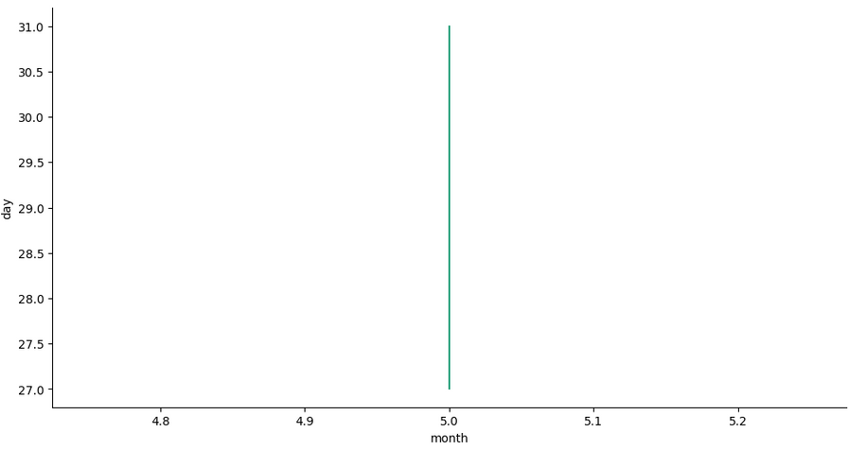
CODING
from matplotlib import pyplot as plt import seaborn as sns
def _plot_series( series, series_name, series_index= 0): from matplotlib import pyplot as plt
import seaborn as sns
palette = l ist( sns. palettes. mpl_palette(' Dark 2 ' )) xs = series[' month']
ys = series[' day']
output
plt. plot( xs, ys, label=series_name, color=palette[ series_index
% len( palette)])
f ig, ax = plt. subplots( f igsize=( 10, 5. 2 ) , layout=' constrained') df_sorted = _df_5. sort_values(' month', ascending=True)
_plot_series( df_sorted, ' ' ) sns. despine( f ig=fig, ax=ax) plt. xlabel(' month')
_ = plt. ylabel(' day')

Slide 13
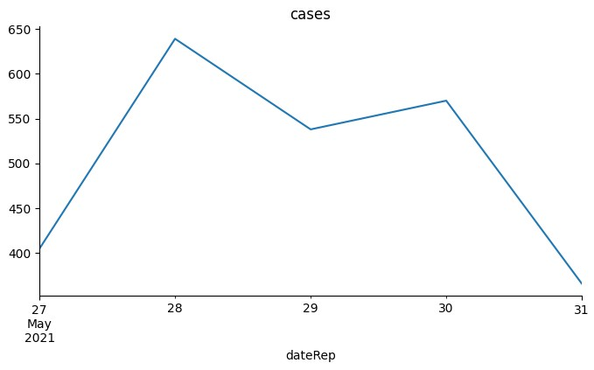
CODING
output
from matplotlib import pyplot as plt import seaborn as sns
_df_10[' cases']. plot( kind=' l ine', f igsize=( 8, 4), t i t le=' cases') plt. gca(). spines[[' top', ' r ight']]. set_visible( False)

Slide 14
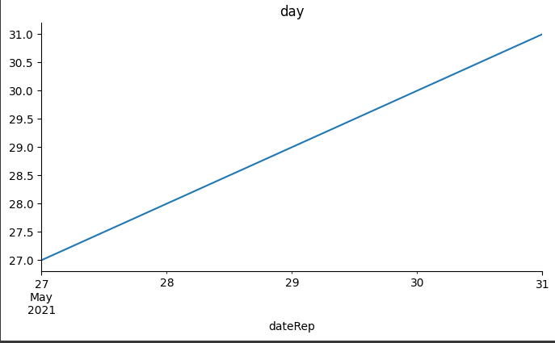
CODING
output
from matplotlib import pyplot as plt
_df_9[' day']. plot( kind=' l ine', f igsize=( 8, 4), t i t le=' day') plt. gca(). spines[[' top', ' r ight']]. set_visible( False)

Slide 15
CODING
import pandas as pd
data = pd. read_csv(' Covid_19_cases4. csv')
data[' date Rep'] = pd. to_datetime( data[' date Rep'])
cases_by_country = data. groupby(' countriesAnd Territories') [ ' cases']. sum()
deaths_by_country = data. groupby(' countriesAnd Territories') [ ' deaths']. sum()
total_cases = data[' cases']. sum()
total_deaths = data[' deaths']. sum()
total_countries = data[' countriesAnd Territories']. nunique() print(" Total Cases by Country:")
print( cases_by_country)
print("\ n Total Deaths by Country:") print( deaths_by_country)
print("\ n Overall Summary Statistics:") print( f " Total Cases: {total_cases}")
print( f " Total Deaths: {total_deaths}")
print( f " Total Countries: {total_countries}")
output
Total Cases by Country: countriesAndTerritories
Austria | 184416
Belgium | 288119
Bulgaria | 171236
Croatia | 113168
Cyprus | 37700
Czechia | 421221
Denmark | 69188
Estonia | 62916
Finland | 34760
France | 2020808
Germany | 1234058
Greece | 210201
Hungary | 371613
Iceland | 527
Ireland | 42057
Italy | 1290738
Latvia | 46912
Liechtenstein Lithuania
Luxembourg Malta
Netherlands Norway
...
437
77040
14464
7586
557983
53995
Overall Summary Statistics: Total Cases: 9994560
Total Deaths: 178247
Total Countries: 30

